Slide 1


IBM Professional Certificate in Data Science:
Applied Data Science Capstone Project
Author: Andrew Murtagh
Date: 30 Sep 2025

Slide 2

Outline
Executive Summary
Introduction
Methodology
Results
Conclusion
Appendix

Slide 3
Executive Summary - I/II
The project focused on predicting via appropriate modelling, whether the first stage of Falcon 9 would land successfully.
Publicly available datasets were sourced and cleaned to ensure high data quality. Exploratory data analysis was performed to uncover key relationships, while feature engineering and selection techniques were applied to improve model performance.
Multiple machine learning algorithms, such as logistic regression, decision trees, support vector machines, and k-nearest neighbours, were evaluated using cross-validation and grid search to optimize hyperparameters. The best-performing model was selected based on accuracy and business relevance.
The best performing model, based on test data application was determined to be logistic regression, achieving the highest accuracy scores of all models developed and tested.

Slide 4
Introduction
This project, completed as part of the IBM Professional Certificate in Data Science, was completed to demonstrates the practical application of knowledge and skills acquired through successful completion of the relevant course module sequence.
The project’s objective is to solve a real-world business problem using data science methodologies, including data collection, preparation, analysis, and predictive modeling: SpaceX advertises Falcon 9 launches at $62 million, significantly less than competitors' $165+ million (due to reusable first-stage boosters). Predicting whether the first stage will land successfully allows estimation of launch costs. This insight helps competing companies much more effective bidding against SpaceX.

Slide 5

Section 1

Slide 6
Methodology
The following project phases were completed in compiling this report:
Data collection
Data processing (‘wrangling’).
Exploratory data analysis (EDA) using visualisations and SQL
Interactive visual analytics using Folium and Plotly Dash
Predictive analysis by building, tuning and evaluating classification models

Slide 7
Data Collection

Slide 8
Data Collection Flowchart – SpaceX API
```mermaid
flowchart TD
A[Start: Import libraries] -->|import requests, pandas| B[Set SpaceX API endpoint]
B -->|url = "https://api.spacexdata.com/v4/launches"| C[Send GET request to endpoint]
C -->|response = requests.get(url)| D[Receive JSON response]
D -->|launches = response.json()| E[Parse response with .json()]
E -->|Extract fields: name, date_utc, success, details| F[Create pandas DataFrame]
F -->|df = pd.DataFrame(data)| G[Display sample output]
G -->|df.head()| H[Export data to CSV (optional)]
H -->|df.to_csv("spacex_launches.csv")| I[End]
```
GitHub URL of the completed SpaceX API calls

Slide 9
Data Collection Flowchart - Scraping
```mermaid
flowchart TD
A[Start: Import libraries] -->|import requests, BeautifulSoup, pandas| B[Set target web URL]
B -->|url = "https://example.com/data"| C[Send GET request to web page]
C -->|response = requests.get(url)| D[Parse HTML response]
D -->|soup = BeautifulSoup(response.text, "html.parser")| E[Locate relevant HTML elements]
E -->|data_elements = soup.find_all(...)| F[Extract and clean text data]
F -->|processed_data = [el.text.strip() for el in data_elements]| G[Create pandas DataFrame]
G -->|df = pd.DataFrame(processed_data)| H[Display sample output]
H -->|df.head()| I[Export data to CSV (optional)]
I -->|df.to_csv("scraped_data.csv")| J[End]
GitHub URL of the completed web scraping notebook

Slide 10
Data Wrangling Flowchart
```mermaid
flowchart TD
A[Import Libraries] -->|import pandas as pd, import numpy as np| B[Load Dataset]
B -->|df = pd.read_csv("https://.../dataset_part_1.csv")| C[Missing Value Analysis]
C -->|df.isnull().sum()/len(df)*100| D[Data Type Inspection]
D -->|df.dtypes| E[Aggregations]
E -->|df['LaunchSite'].value_counts(), df['Orbit'].value_counts()| F[Outcome Analysis]
F -->|df['Outcome'].value_counts()| G[Label Engineering]
G -->|bad_outcomes = {...}; df['landing_class'] = ...| H[Export/Display]
H -->|df.head(), print(df[['Class']].head(8))| I[End]
```
GitHub URL of completed data wrangling

Slide 11
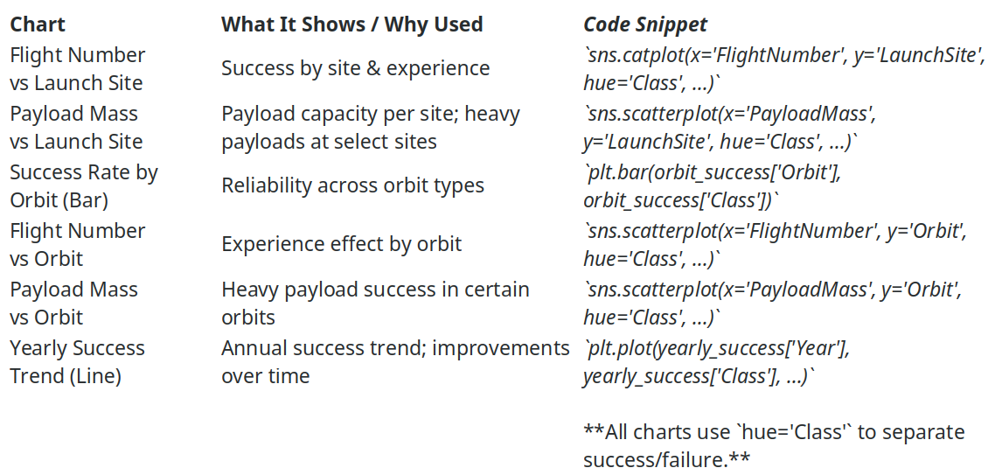
EDA with Data Visualization
GitHub URL of completed EDA with data visualization notebook

Slide 12
EDA with SQL
Displayed unique launch site names (SELECT DISTINCT "Launch_Site")
Selected 5 records where launch sites start with 'CCA' (WHERE "Launch_Site" LIKE 'CCA%' LIMIT 5)
Summed payload mass for NASA (CRS) launches (SUM("PAYLOAD_MASS__KG_") WHERE "Customer" LIKE '%NASA (CRS)%')
Calculated average payload mass for booster version F9 v1.1 (AVG("PAYLOAD_MASS__KG_") WHERE "Booster_Version" = 'F9 v1.1')
Found date of first successful ground pad landing (MIN("Date") WHERE "Landing_Outcome" = 'Success (ground pad)')
Listed boosters with success on drone ship and payload mass between 4000 and 6000 kg (WHERE "Landing_Outcome" = 'Success (drone ship)' AND "PAYLOAD_MASS__KG_" > 4000 AND "PAYLOAD_MASS__KG_" < 6000)
Counted total number of successful and failed mission outcomes (COUNT(*) GROUP BY "Mission_Outcome")
Identified booster_versions that carried the maximum payload mass (WHERE "PAYLOAD_MASS__KG_" = (SELECT MAX("PAYLOAD_MASS__KG_")))
Listed records for 2015 with failure landing outcomes on drone ship, including month, booster version, and launch site (WHERE substr("Date", 0, 5) = '2015' AND "Landing_Outcome" = 'Failure (drone ship)')
Ranked landing outcome counts between two dates in descending order (COUNT(*) GROUP BY "Landing_Outcome" WHERE "Date" >= '2010-06-04' AND "Date" <= '2017-03-20' ORDER BY outcome_count DESC)
GitHub URL of completed EDA with SQL notebook

Slide 13
Build an Interactive Map with Folium
Markers: Added to indicate the exact geographic locations of all SpaceX launch sites.
Purpose: Visually identify and compare launch site positions on the map.
Circle Markers: Used to highlight individual launches and distinguish between successful and failed launches (often colored differently). Purpose: Show launch outcomes at each site and provide an at-a-glance comparison of performance.
Lines (Polylines/Distance): Drawn between launch sites and relevant geographical points (e.g., nearest cities, ocean, or landing zones). Purpose: Visualize distances, routes, and spatial relationships that might affect launch logistics or outcomes.
These folium objects were added to enable interactive geographic analysis, allowing users to:
Locate launch sites and their surroundings
Assess launch success distribution
Understand spatial factors affecting missions
GitHub URL of completed interactive map with Folium map

Slide 14
Build a Dashboard with Plotly Dash
Components included:
Pie chart: Success by site or per site (success vs. failure); enables site-level performance comparison.
Dropdown: Select site; filters all plots for focused analysis.
Ratlianle:
Scatter plot: Payload vs. success, colored by booster; reveals payload-success trends.
RangeSlider: Select payload range; refines scatter plot data.
Why these compnents?
- Pie chart and scatter plot: Key performance and technical relationships.
- Dropdown and slider: Interactive, user-driven exploration.
GitHub URL of your completed Plotly Dash lab

Slide 15
Predictive Analysis (Classification) – Process / Flowchart
Process Outline
- Standardised input features for fair model comparison
- Split data to prevent overfitting and enable unbiased testing
- Used GridSearchCV to optimise model hyperparameters
- Assessed models using confusion matrix and test accuracy
- Selected the classifier with highest test performance for prediction
```mermaid
flowchart TD
A[Load & preprocess data] --> B[Standardize features]
B --> C[Split into train/test sets]
C --> D[Train multiple classifiers (Logistic Regression, SVM, Decision Tree)]
D --> E[Hyperparameter tuning with GridSearchCV]
E --> F[Evaluate with confusion matrix & test accuracy]
F --> G[Compare models]
G --> H[Select best performing model]
```
GitHub URL of completed predictive analysis lab

Slide 16

Section 2

Slide 17
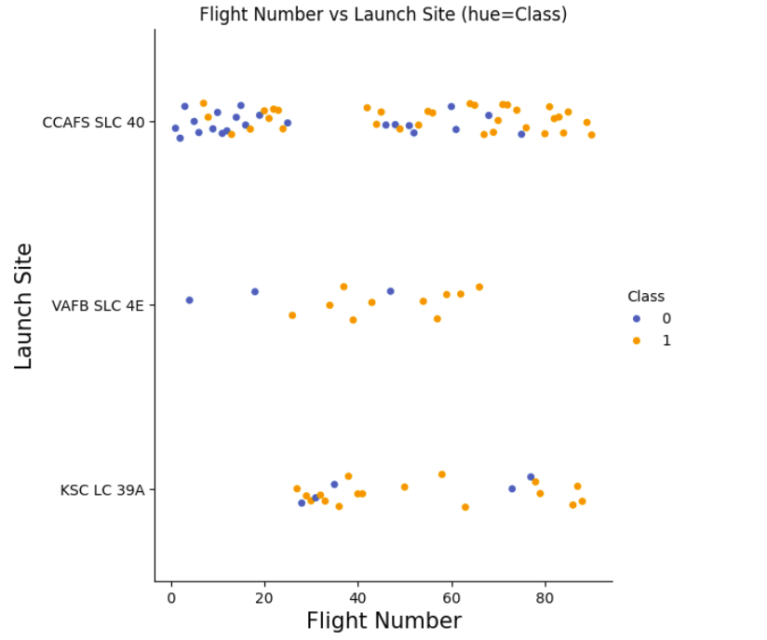
Flight Number vs. Launch Site
Launch sites with more flights (higher flight numbers) showed higher concentrations of successful landings (indicated by colour in the plot and class or success value of '1').
Early flight numbers usually clustered at one or two sites, suggesting initial launches were limited to certain locations.
Some sites (e.g., KSC LC-39A, CCAFS SLC-40) began to show more successes as flight numbers increased, reflecting operational learning and technical improvements.
Sites with fewer launches had more scattered outcomes and less clear success patterns.
Overall: Success rate improved with experience (higher flight numbers), and this improvement was most pronounced at major launch sites

Slide 18
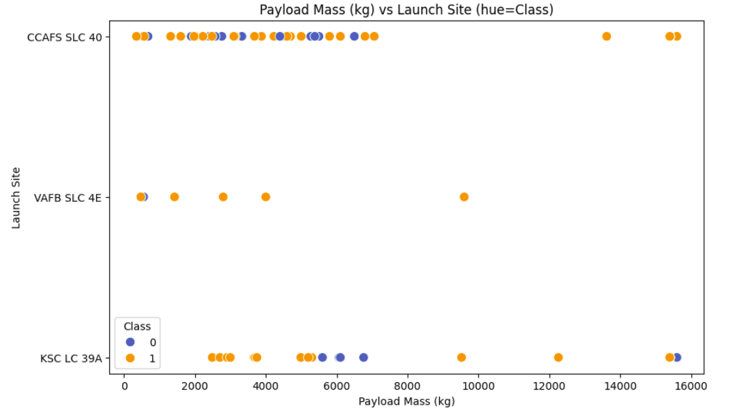
Payload vs. Launch Site
Launch sites showed distinct payload profiles; some sites (like VAFB SLC-4E) only handled lighter payloads, while others (e.g., KSC LC-39A, CCAFS SLC-40) supported heavier payloads.
Success rates (shown via colour / hue) tended to be higher for certain sites with a wider payload range, especially those handling larger payloads.
Sites with heavier payload launches generally showed more successful outcomes, indicating better infrastructure or operational experience.
There were few, if any, heavy payload launches at sites specialising in lighter missions.
Overall: Payload capacity and launch success varied by site, with major sites demonstrating capability and reliability for heavier missions.

Slide 19
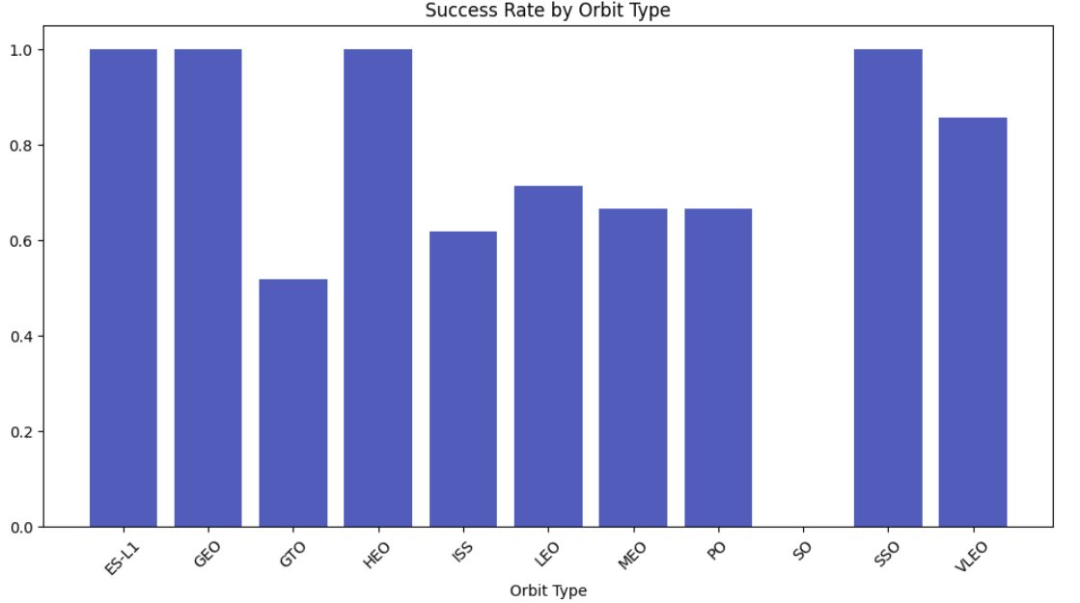
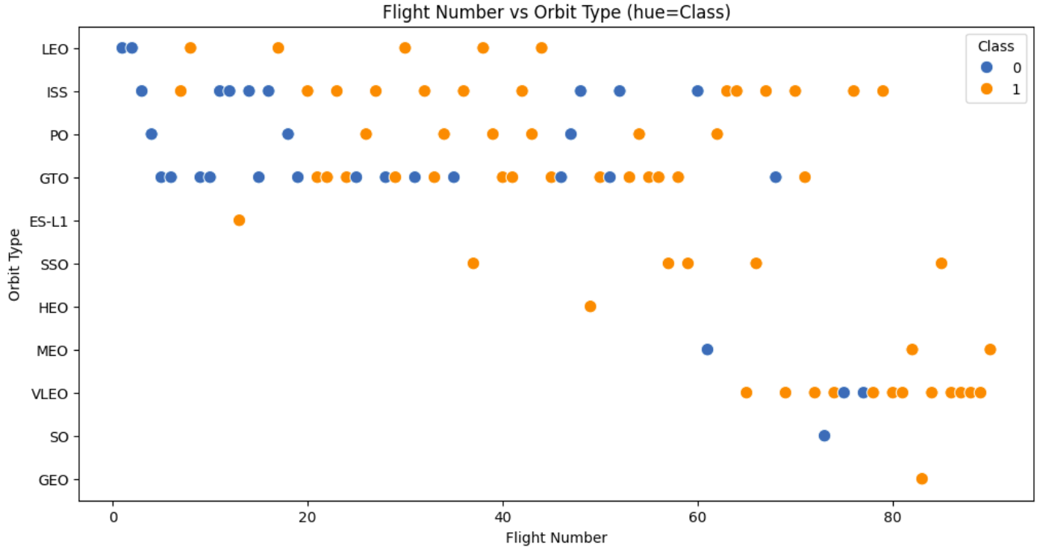
Bar plot:
Orbits like LEO, ISS, and PO showed higher success rates, indicating these are more reliable or better understood mission profiles.
GTO and some specialized orbits had lower success rates, suggesting greater technical challenge or risk.
Scatter plot
Heavy payloads in orbits like LEO, ISS, and Polar tended to have more successful outcomes.
GTO launches displayed mixed outcomes, with both successes and failures across payload sizes.
Some orbits had very few launches, resulting in scattered success rates.
Overall:
Success rate is strongly dependent on orbit type, with major operational orbits (LEO, ISS) outperforming transfer or specialized orbits.
Payload size and orbit type together influence success, especially in high-frequency, high-reliability orbits.
Success Rate vs. Orbit Type

Slide 20
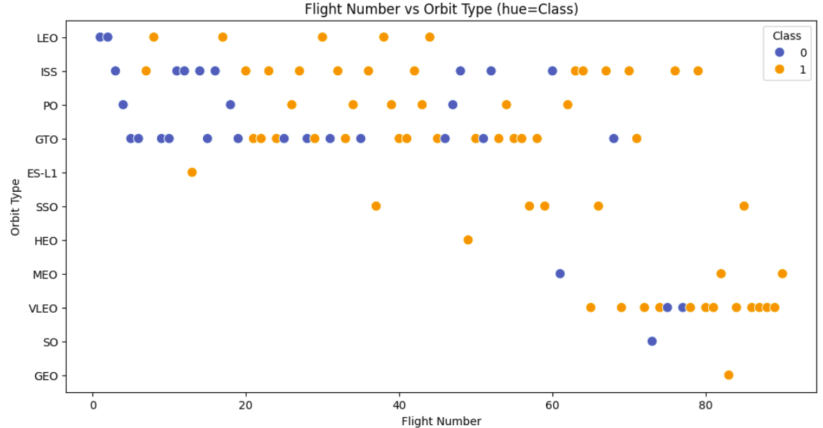
Flight Number vs. Orbit Type
For LEO and ISS orbits, success rates increased with higher flight numbers, showing learning and improved reliability over time.
GTO launches showed mixed outcomes across all flight numbers, indicating persistent difficulty or higher risk for this orbit.
Some orbits had clusters at specific flight numbers, suggesting they were targeted during particular periods or missions.
High flight numbers generally correlated with more successes, especially in orbits with frequent launches.
Overall: Operational experience (higher flight number) most benefits common orbits (LEO, ISS), while challenging orbits (GTO) remain less predictable.

Slide 21
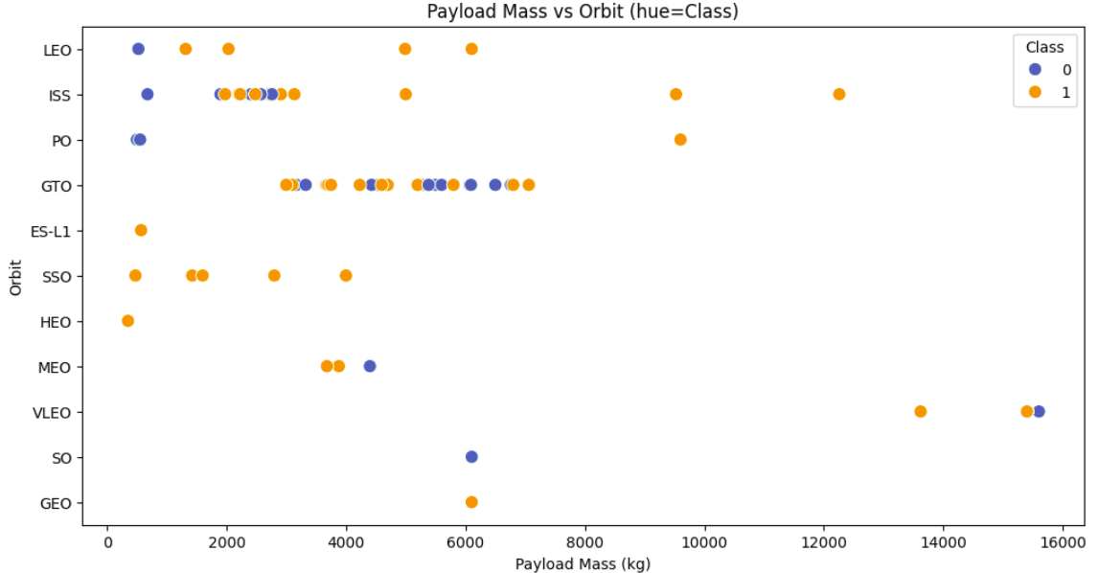
Payload vs. Orbit Type
Heavy payloads are more common in LEO, ISS, and Polar orbits; these orbits show higher concentrations of successful launches.
GTO and GEO orbits have a wider range of payloads but display mixed success rates, indicating they are more technically challenging.
Some orbits (e.g., ES-L1, HEO) have very few launches and scattered payload sizes, making their patterns less clear.
Overall: Major operational orbits (LEO, ISS, Polar) handle larger payloads and achieve better success, while special-purpose or transfer orbits (GTO, GEO) show more variability in both payload size and outcome.

Slide 22
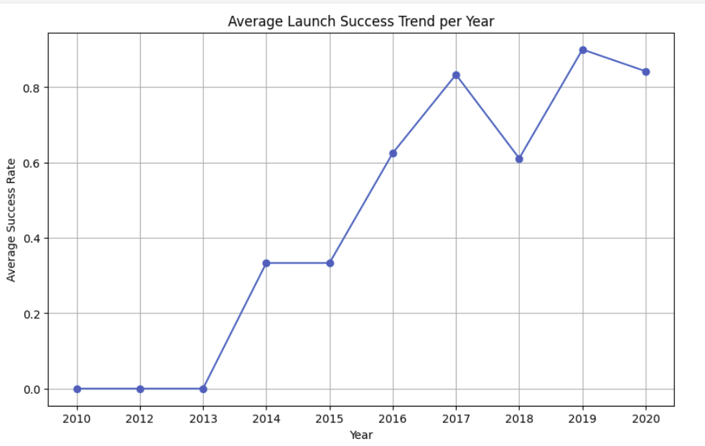
Launch Success Yearly Trend
The plot shows a clear upward trend in launch success rate over the years.
After 2013, SpaceX's launch outcomes improved steadily, with notable increases post-2015.
Early years had low and variable success rates; later years stabilized at higher rates.
Pattern indicates learning curve, technical improvements, and operational maturity leading to more reliable launches over time.

Slide 23
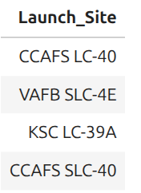
All Launch Site Names
The list of unique (‘distinct’) names of launch sites is retrieved using the following sql code:
This returns the following data:

Slide 24
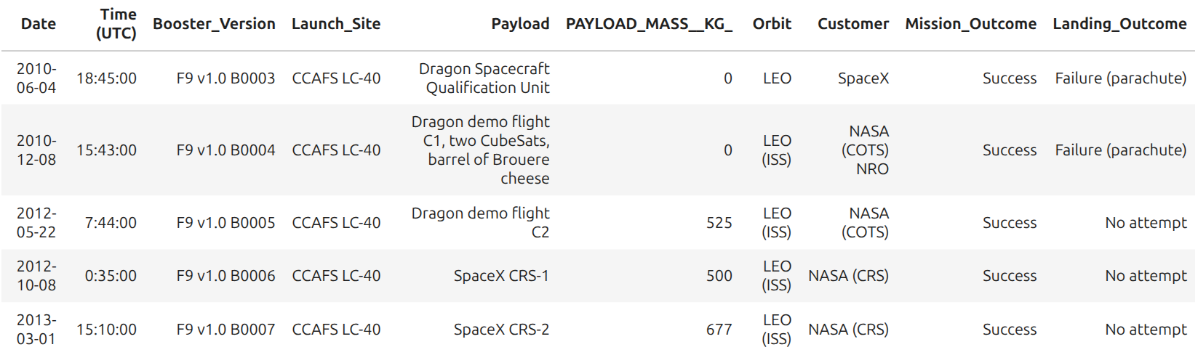
Launch Site Names Begin with 'CCA'
Finding 5 Records where launch sites begin with `CCA` (limited to 5) is given by the code:
The resulting data returned is laid out below:

Slide 25
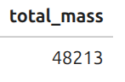
Total Payload Mass
The total payload carried by boosters from NASA can be retrieved using the following code which sums payloads in kg by Customer (‘like’ NASA):
Which returns the following result:

Slide 26
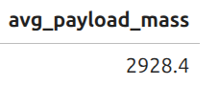
Average Payload Mass by F9 v1.1
The average payload mass carried by booster version F9 v1.1 can be calculated as follows – average the payload mass in kg where the booster version is F9 v1.1:
With the result:

Slide 27
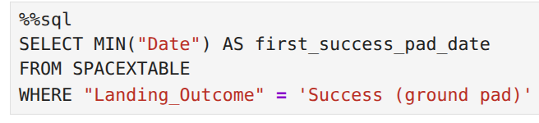
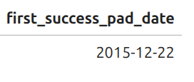
First Successful Ground Landing Date
Date of the first successful landing outcome on ground pad can be found using the following code which gets the MIN (earliest) date where the Landing Outcome was successful (‘Success (ground pad)’):
Giving the result:

Slide 28
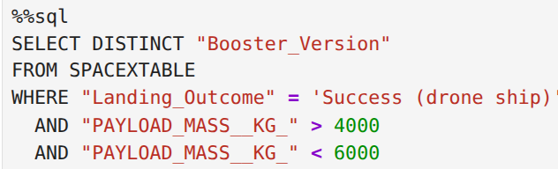
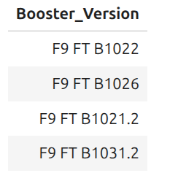
Successful Drone Ship Landing with Payload between 4000 and 6000
Boosters which have successfully landed on drone ship and had payload mass greater than 4000 but less than 6000 can be listed via the following sql code which returns the unique (‘distinct’) booster names having payloads of between 4000 and 6000 (kg) and where "Landing_Outcome" = 'Success (drone ship)':
With the result:

Slide 29
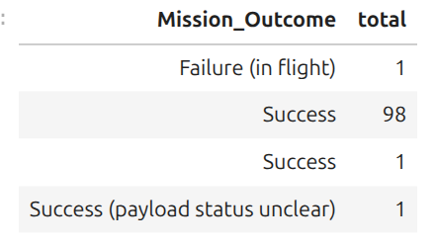
Total Number of Successful and Failure Mission Outcomes
Total number of successful and failure mission outcomes may be calculated with the following sql, which COUNTS mission outcomes by type:
Returning:

Slide 30
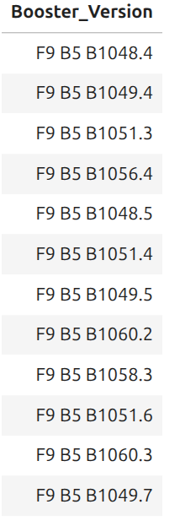
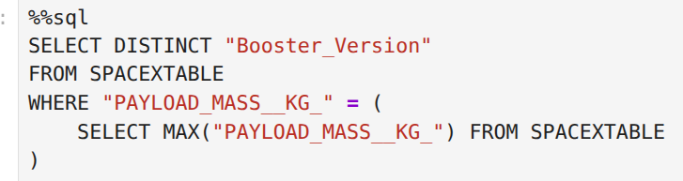
Boosters Carried Maximum Payload
Getting at Boosters which have carried the maximum payload mass is achieved by selecting unique (DISTINCT) values of Booster_Version where (using a subquery) the payload is maximum:
The sql retuns the relevant list of boosters

Slide 31
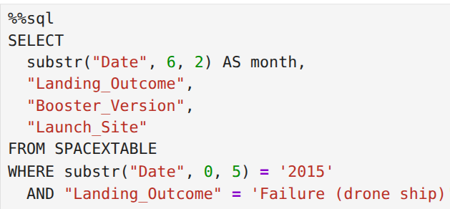
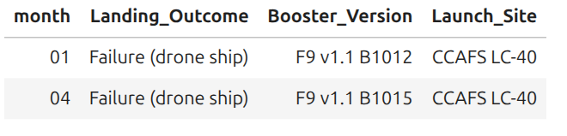
2015 Launch Records
Failed drone ship landing_outcomes, their booster versions, and launch site names listed for 2015 can be arrived at using the following sql code (which limits the search to year 2015 and returns "Landing_Outcome", “Booster_Version" and "Launch_Site" where the :"Landing_Outcome" = 'Failure (drone ship)':
Results:
Note that as SQLLite doesn’t support monthnames, we need to use substr(Date, 6,2) as month to get the months and substr(Date,0,5)='2015' for year.

Slide 32
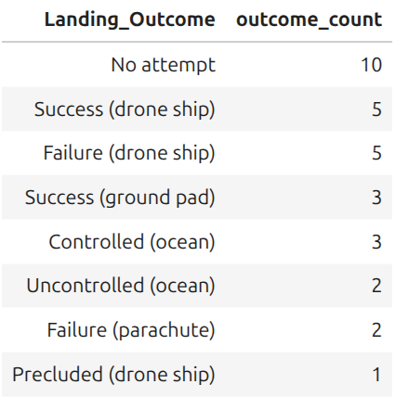
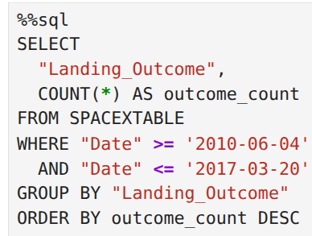
Rank Landing Outcomes Between 2010-06-04 and 2017-03-20
Ranked landing outcome counts (such as Failure (drone ship) or Success (ground pad)) between the date 2010-06-04 and 2017-03-20, in descending order can be gotten by counting Landing_Outcomes between these dates and sorting DESCending:
Results:

Slide 33

Section 3

Slide 34
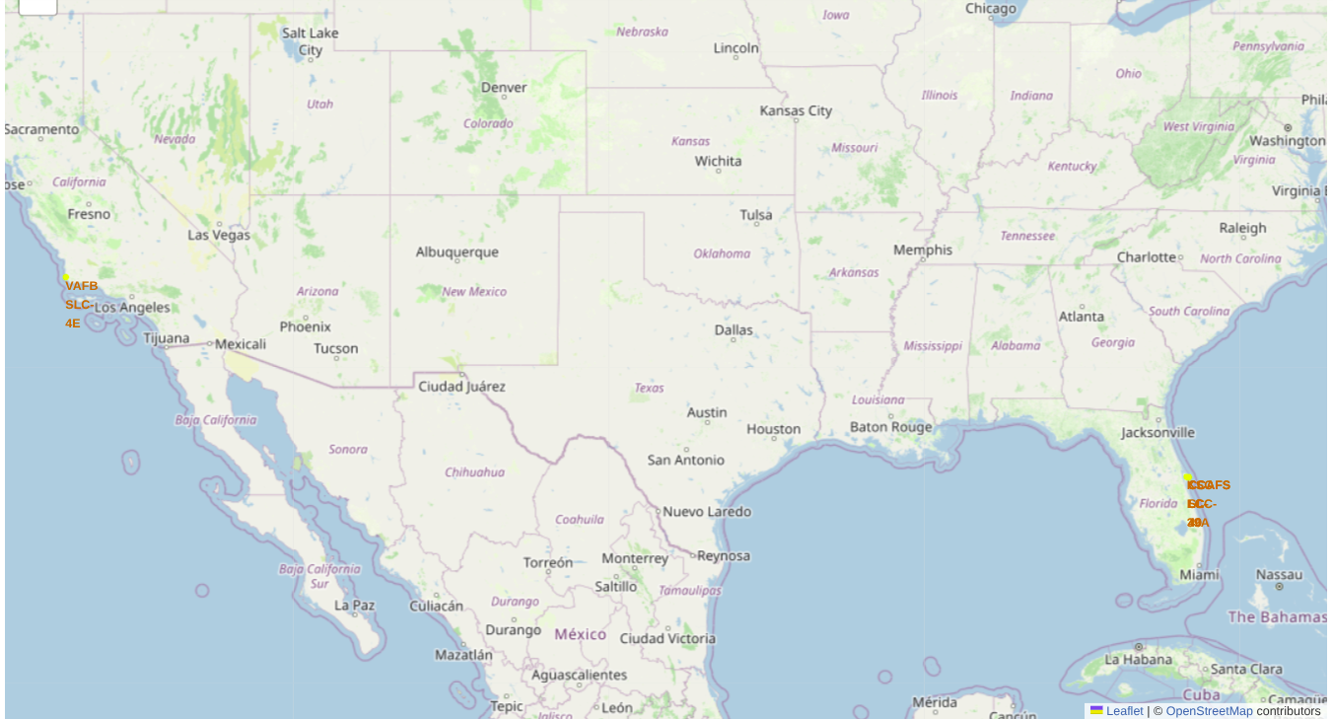
Mapped Launch Sites Using Folium
The screen grab of mapped launch sites is shown below. The map shows launch sites marked with yellow circle on west and east coast locations.

Slide 35
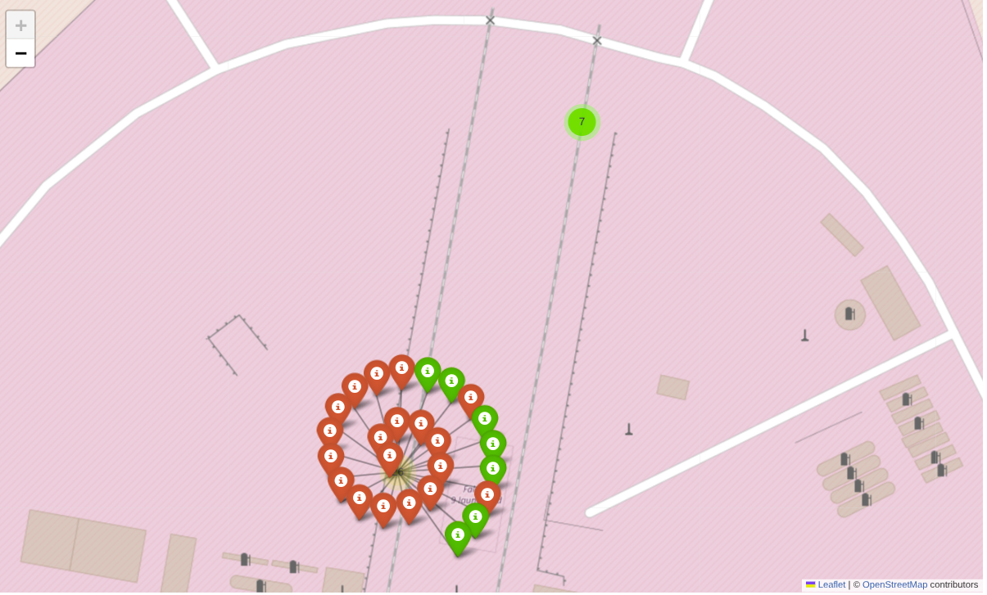
Successful/Failed launches by Mapped Launch Site
Next we layered markers for each site location, tagging as either successful or failed. Green and red markers indicate successful and failed launches respectively.

Slide 36
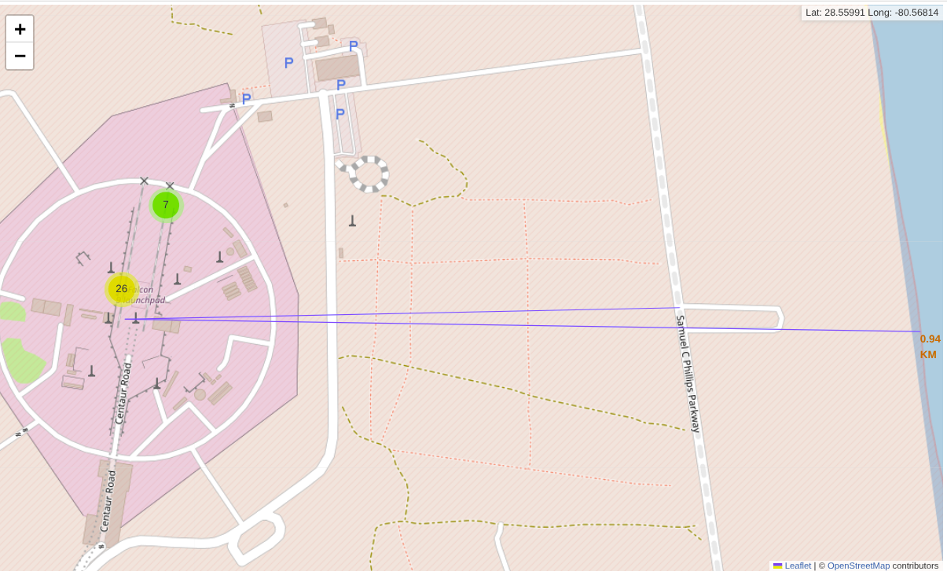
Launch Site Proximity to Infrastructure
Next, for a sample of infrastructure elements, such as highway, coastline, we calculate and plot the distance from a given launch site, illustrating that launch sites are located relatively close to coastlines and away from urban centres.
Observations:
Launch sites are sited close to coastlines and away from urban / populated centres.
While some roads are relatively close to launch sites (for basic site logistics), sites are typically located away from busy highways and railroads, presumably for safety and noise consideratoins for example.

Slide 37

Section 4

Slide 38
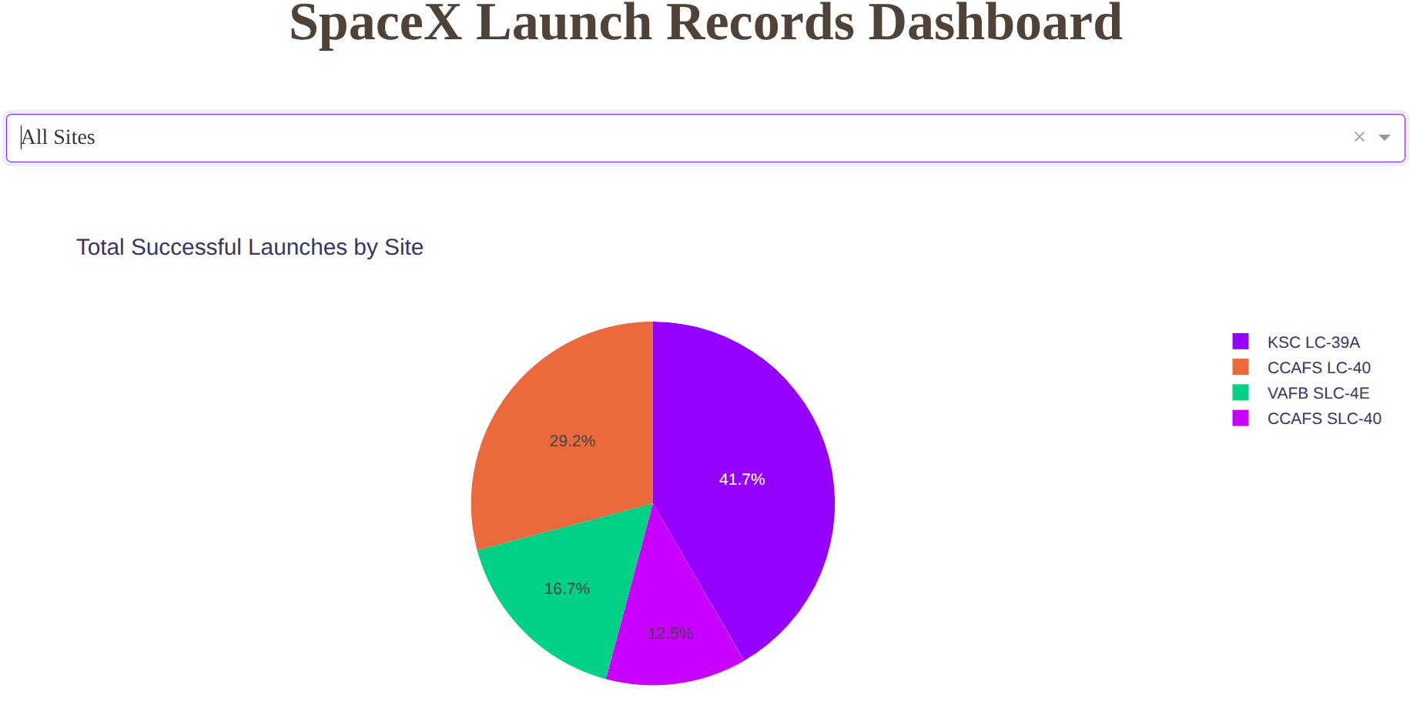
SpaceX Launch Records Dashboard – Success Count by Launch Site
Pie chart elements:
Each slice represents a SpaceX launch site (e.g., CCAFS SLC-40, KSC LC-39A, VAFB SLC-4E).
The size of each slice shows the total number of successful launches at that site.
Color coding distinguishes sites for easy visual comparison.
Findings
Sites with larger slices (e.g., CCAFS SLC-40, KSC LC-39A) have the highest number of successful launches, indicating they are the main operational hubs.
Smaller slices (e.g., VAFB SLC-4E) have fewer successes, suggesting secondary or specialized use.
The chart provides a clear, at-a-glance overview of which sites contribute most to SpaceX’s launch success.
Helps identify the company’s strategic and high-performing locations.

Slide 39
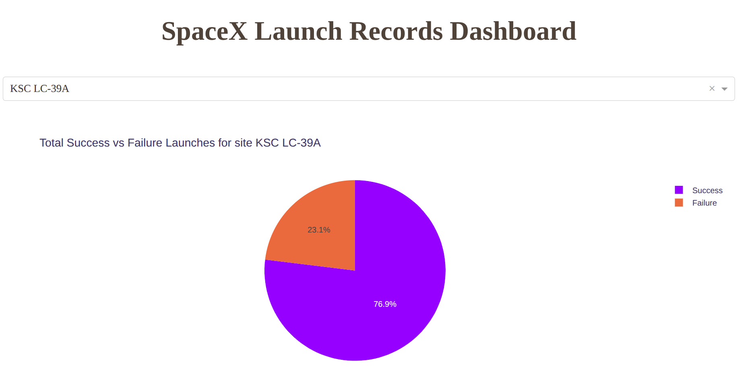
Dashboard – Highest Launch Site Success Ratio
Important elements:
Chart (pie or bar) shows success ratio for each launch site.
KSC LC-39A has a large success slice (76.9%) and a smaller failure slice (23.1%).
Slices/bars are color-coded for easy distinction between success and failure
Findings:
KSC LC-39A stands out as the most reliable site, with over three-quarters of launches successful.
The small failure proportion highlights operational efficiency and reliability at this location.
This visual evidence makes KSC LC-39A SpaceX’s top-performing site for launch success.
Useful for strategic decisions—future launches can be prioritized at high-performing sites like KSC LC-39A.

Slide 40
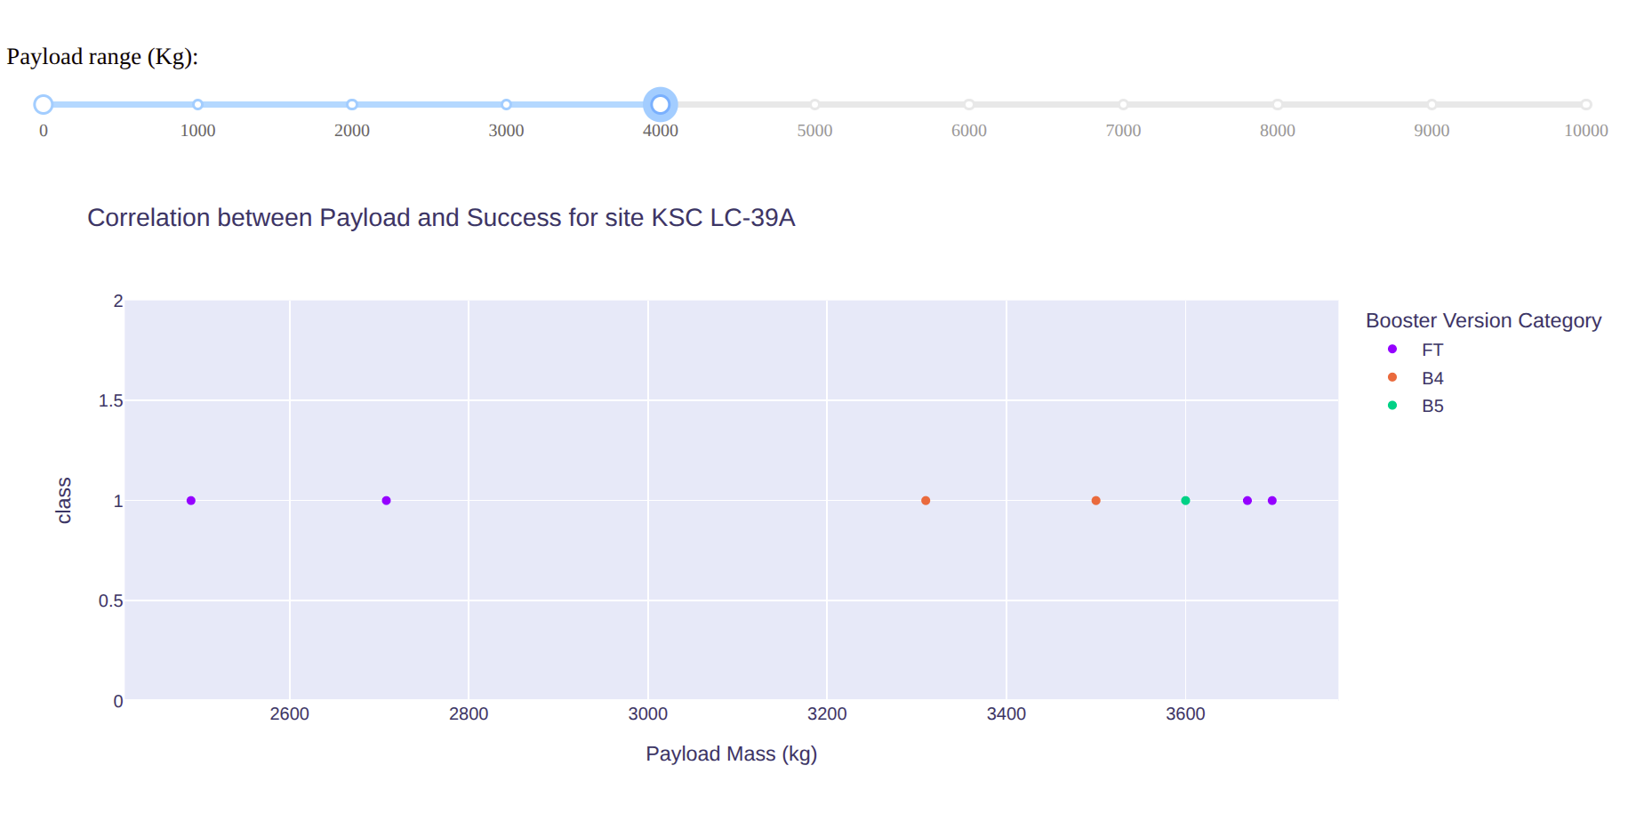
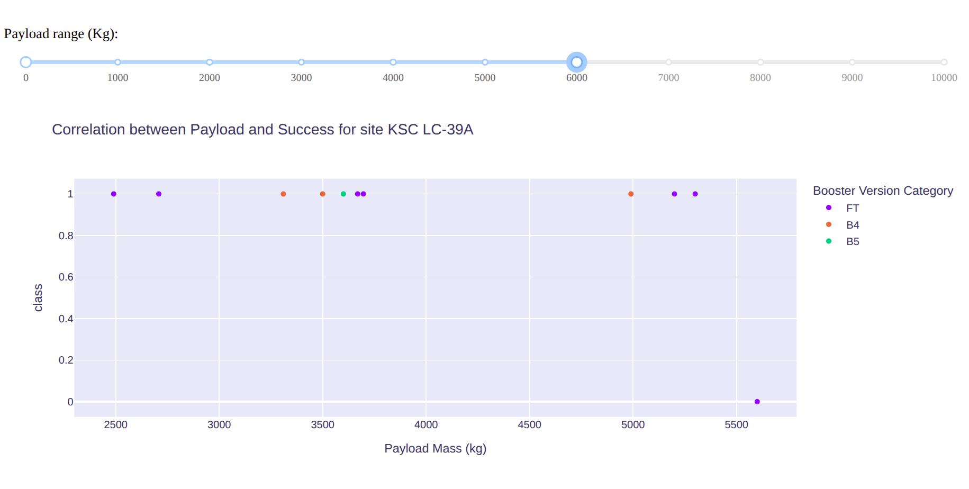
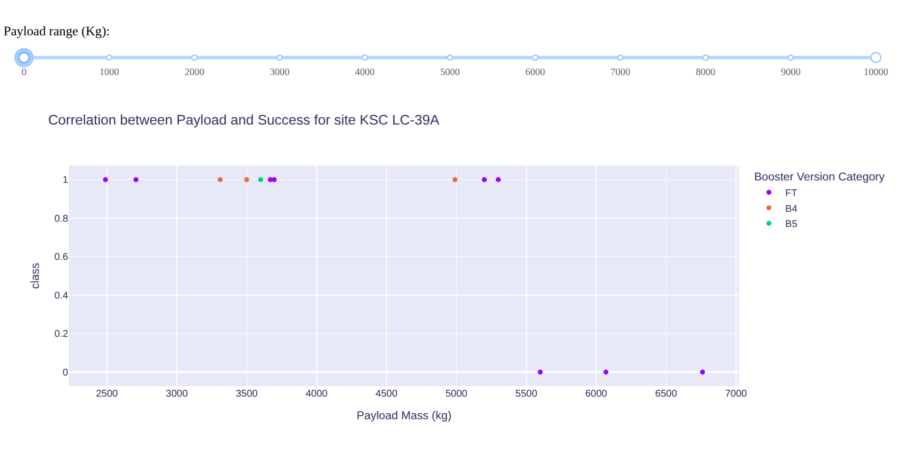
Dashboard - Payload vs. Launch Outcome – 4, 6, and 10Kg
Important elements:
Plots show payload mass vs. launch outcome, with points colored by booster version.
A slider allows users to filter data for payload ranges (e.g. 0–4, 0–6, 0–10 tons), each of which displays different distributions of successful and failed launches for each booster.
Findings:
Success is highest for Block 5 and FT boosters, especially as payload increases.
Lighter payloads (0–4t) have high success across all boosters; heavier payloads (up to 10t) are reliably launched by advanced boosters.
The slider interaction helps users see how payload and booster advancements drive SpaceX’s launch reliability.

Slide 41

Section 5

Slide 42
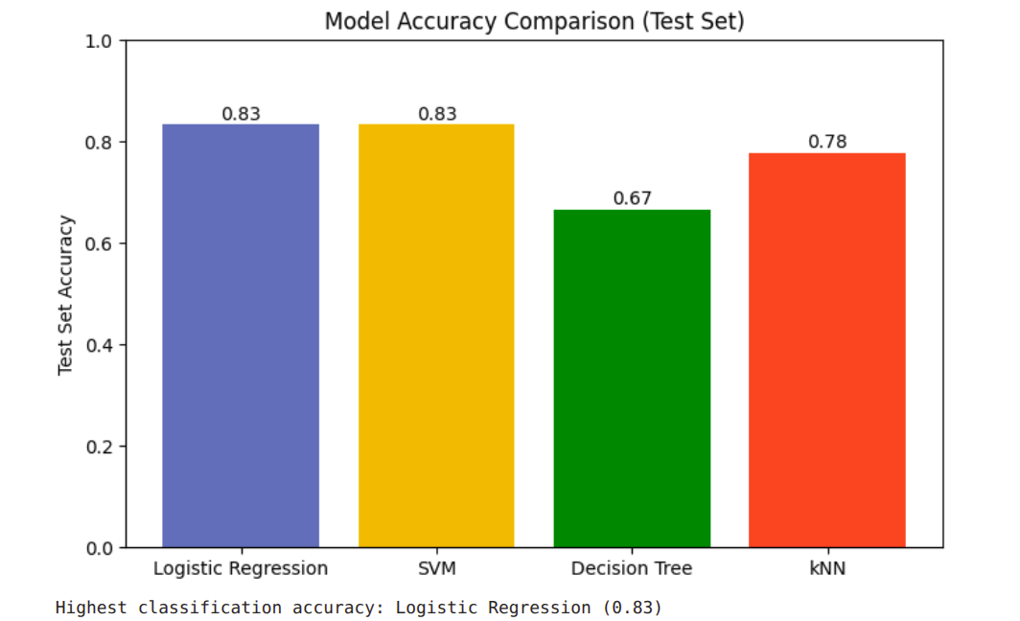
Classification Accuracy
Built model accuracy is visualised using a bar chart by classification models
The bar chart clearly identifies the best-performing model for predicting SpaceX launch outcomes.
The top scoring model demonstrates superior generalisation and reliability on unseen data, making it the preferred choice for practical deployment and further analysis.

Slide 43
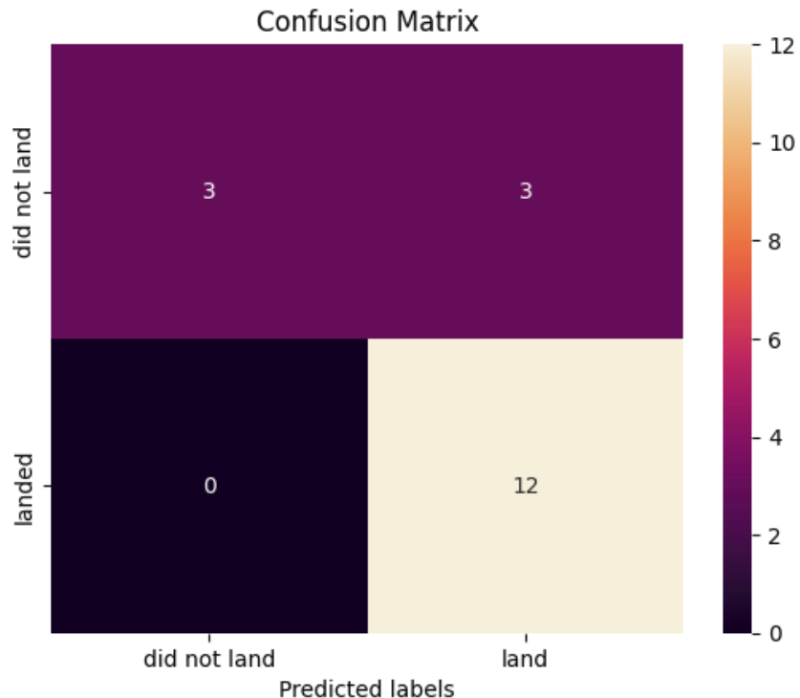
Confusion Matrix
The model never misses actual successes (0 false negatives).
It sometimes incorrectly predicts failures as successes (3 false positives).
Most predictions are correct (3 failures + 12 successes).
The model is highly sensitive (identifies all successes), and moderately specific (some failures misclassified as successes).
Overall, excellent at identifying successful launches, with a few mistakes on failed ones.

Slide 44
Conclusions
Point 1
Point 2
Point 3
Point 4
…

Slide 45
Appendix
Include any relevant assets like Python code snippets, SQL queries, charts, Notebook outputs, or data sets that you may have created during this project

Slide 46


